Slide 1
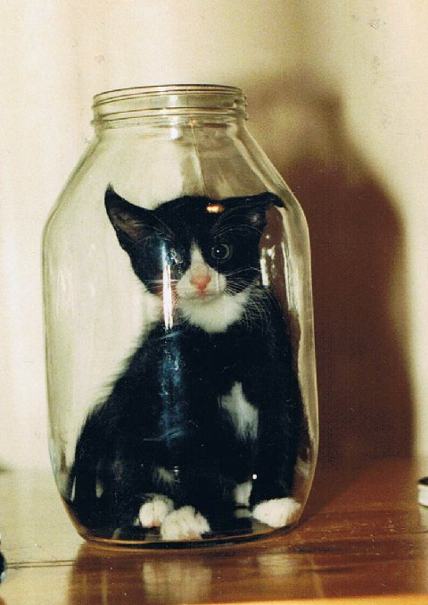
What’s the connection between me and this milk bottle?

Slide 2
To find out we first need to look at the relative surface areas of spheres ….
12 units

Slide 3
And for the green sphere ….
20 units

Slide 4
Count
28
Total surface circumference =
28 × 12units
4 × 20units
= 336 units
= 80 units
Note that the effect will be increased because the balls are spherical

Slide 5
How does this affect flow rate?

Slide 6
Enzyme (lactase)

Slide 7
Above we see lactose (blue sphere) digested by lactase into glucose and galactose (blue semi spheres)

Slide 8
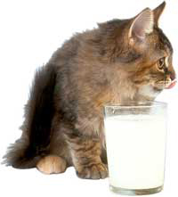
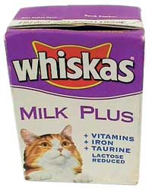
This milk is lactose reduced and therefore I can digest it better!

