Slide 1
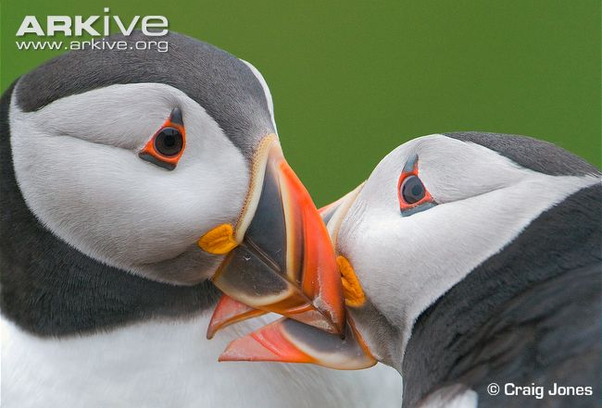
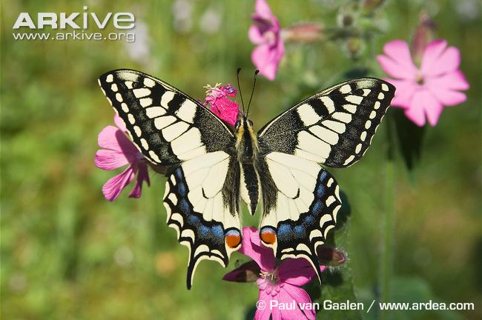
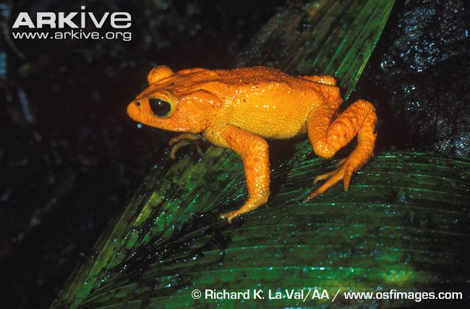
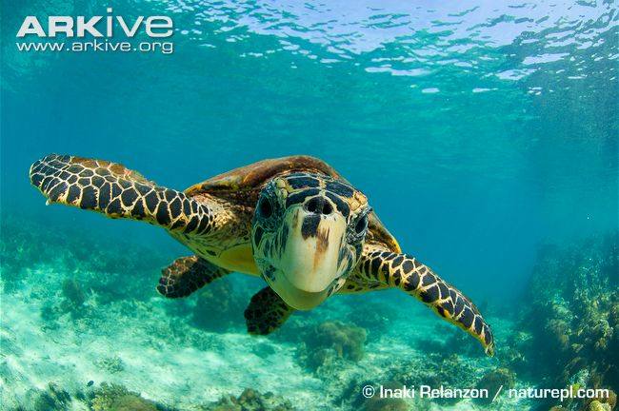
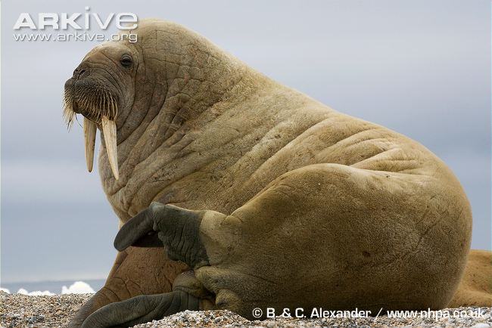
Biodiversity and Evolution
Notes:
Explain that the topic of the session is Biodiversity and Evolution
Ask the students if they can define the term ‘biodiversity’

Slide 2
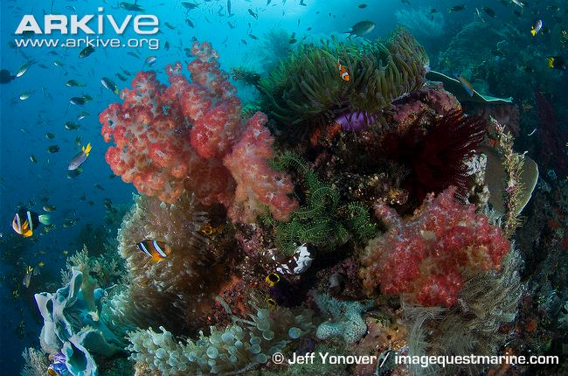
What is biodiversity?
Biological diversity
The simple version - number of different species in a given area
→ Species richness
Coral reef
BUT, it can also be diversity within species
→ Genetic diversity – variation of alleles in a gene pool
Notes:
Explain that biodiversity is a shortened term for ‘biological diversity’.
It is the diversity of life or, more simply, the number of different species in a given area (this area could be anything from a small pond or a large forest to a whole country).
→ Species richness
However, the concept of biodiversity can be rather more complicated than this - it can be the diversity of genes (diversity within a given species), of species (between species), of habitats, or even of ecological roles (the role different species play within the community in which they live).
To demonstrate diversity within a species, ask students to think about how different they all are from each other…eye colour, hair colour, height etc. That’s an example of biodiversity within a species, due to differences in their genetics.
Recap: Genes are made up of DNA and contain the code which determine the structure, function and characteristics of an organism. Genes are heritable, which means they are passed between generations from parents to offspring. Alleles are different forms of the same gene, and the expression of different alleles can sometimes result in differences in the observed characteristics of an individual (for example, hair colour is controlled by genes and the expression of different alleles results in different hair colour. Alleles may be dominant or recessive).

Slide 3
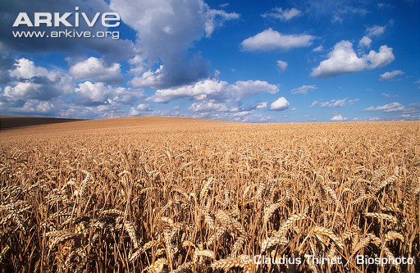
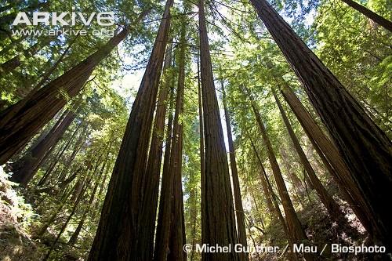
Why is biodiversity important?
Biodiversity is vital for supporting life on Earth and is the foundation of all healthy ecosystems
Crucial to human wellbeing, global food security, sustainable development and poverty reduction
Provides important ‘ecosystem services’
Food – Clean air and water
Medicine – Fertile soils
Cultural, spiritual and religious values
Intrinsic value of nature
Common wheat
Coastal redwoods
Notes:
Why is biodiversity important?
Biodiversity is vital for supporting all life on Earth and is the foundation of healthy, functioning ecosystems upon which all life depends.
Biodiversity is essential for global food security and is crucial to human wellbeing, sustainable development and poverty reduction.
The world’s biodiversity provides many ‘ecosystem services’ – these are natural processes and resources that are provided by natural ecosystems, from which humans then benefit.
E.g. food and many industrial products such as timber, fuel, textiles and medicines. Biodiversity also ensures clean air, water and fertile soils.
Ask the students if they can think of any more examples of ecosystem services.
E.g. soil formation, nutrient, nitrogen, oxygen and carbon cycling, energy production, flood and erosion control, breaking down pollutants, pest and disease control, climate regulation and pollination.
Biodiversity also provides opportunities for recreation, tourism, scientific research and education, and is important for its cultural, spiritual and religious values.
To give the students an idea of how amazingly diverse life is, they can try the short exercise based on one species group: mammals.

Slide 4
Mammalian species diversity exercise
Notes:
The idea of this exercise is to show how diverse species are, even within a given group such as the mammals. It also highlights how evolution can be rather tricky (the answers are not what students may first expect!).
One sheet to be given to each student or each pair of students.
Students must decide which animals are most closely related, and write down the relevant pairs on the dotted lines.
So, for instance, which of the other animals on the sheet is most closely related to the short-beaked echidna?
Students should try and think beyond the obvious to find things that the species may have in common.
Remember to leave this slide up during the exercise, as the answers are on the next few slides.

Slide 5
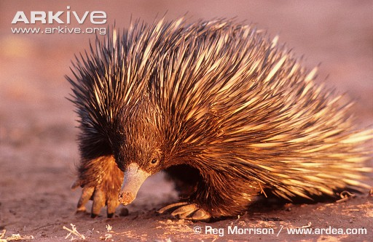
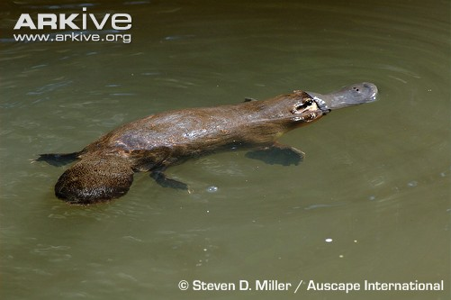
Mammalian species diversity exercise - answers
Short-beaked echidna - Platypus
Monotremes
Notes:
Ask students to provide answers and also give their reasoning as to why they have paired certain species.
Short-beaked echidna and platypus – many people think that the echidna is most closely related to the porcupine, as they both have spines, but this is not the case!
The short-beaked echidna and the platypus are both primitive mammals belonging to a group known as the ‘monotremes’ (these are egg-laying mammals).
These Australian mammals evolved after the continents divided, and any resemblance the echidna has to the porcupine has arisen due to convergent evolution – they have each independently evolved to fit a similar niche in their environment.

Slide 6
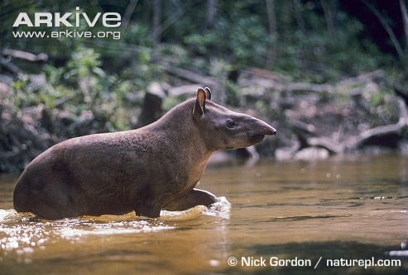
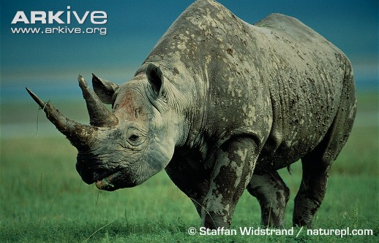
Mammalian species diversity exercise - answers
Lowland tapir – Black rhinoceros
Odd-toed ungulates (Perissodactyls)
Notes:
Lowland tapir and black rhinoceros – these are both odd-toed ungulates (ungulates are basically mammals with hooves)
Odd-toed ungulates (such as horses, tapirs and rhinos) are known as ‘perissodactyls’.

Slide 7
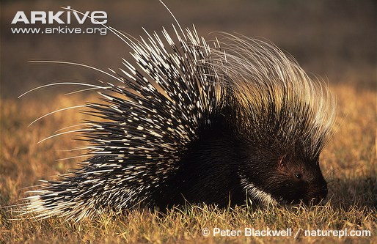
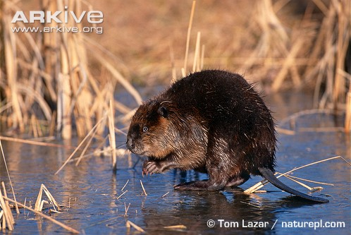
Mammalian species diversity exercise - answers
North African crested porcupine – American beaver
Rodents
Notes:
North African crested porcupine and American beaver - these are both rodents.
Rodents are characterised by a pair of continuously growing incisors in each of the upper and lower jaws. Need to gnaw to keep them shortened.

Slide 8
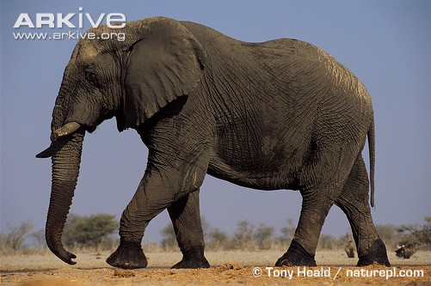
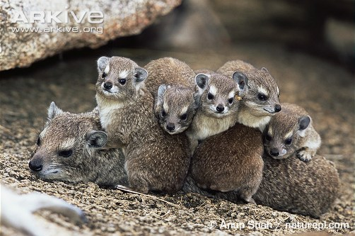
Mammalian species diversity exercise - answers
African elephant - Rock hyrax
Afrotheria
Notes:
African elephant and rock hyrax - both of these species belong to an African species group called the afrotheria, and so are more closely related that anything else on the worksheet.
Other afrotheria species include golden moles, elephant shrews and aardvarks.
However, the closest relative of the elephant is actually the manatee – in fact, if you look closely at a manatee’s flippers, they look very similar to an elephant’s foot (a squashed one!) as you can clearly see the toenails on the ends of the flippers.

Slide 9
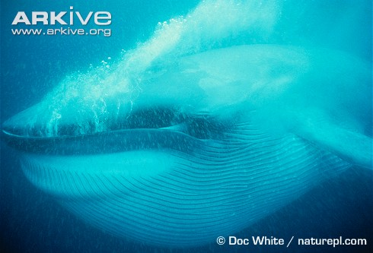
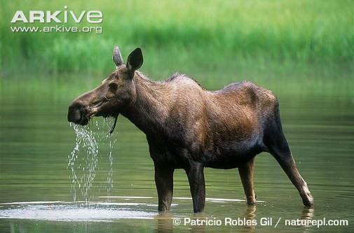
Mammalian species diversity exercise - answers
Blue whale - Moose
Cetaceans + artiodactyls = Cetartiodactyls
Notes:
Although these species look nothing alike, the blue whale and moose are closely related.
They belong to a group called the Cetartiodactyls, which is a combination of cetaceans (whales and dolphins) and artiodactyls (even-toed ungulates such as pigs, deer, sheep, antelope and cattle).
Surprisingly, artiodactyls are more closely related to cetaceans than they are to the perissodactyls that were discussed earlier (the odd-toed ungulates) – this means artiodactyls have a more recent common ancestor with the cetaceans than with perissodactyls.

Slide 10
Why is there so much diversity?
EVOLUTION
The process by which change occurs in the heritable characteristics (genes) of a population over successive generations
→ Changes in allele frequency as a result of gene mutation and natural selection
Evolution results in diversity at every level (from genes to species)
This process happens naturally over a long period of time, and the result is a huge amount of diversity even between related groups with a common ancestor
Notes:
As the mammalian diversity exercise shows, there is a lot of diversity, even within one small group of species.
Explain that there is an incredible amount of biodiversity on our planet (more than 1.8 million described species, and plenty more that we don’t know about yet!).
But why? And how has this happened?
The process responsible for the creation of the incredible amount of biodiversity on Earth is evolution.
Species evolve over time and naturally become different from one another – occurs through a change in the allele frequency which can come about through gene mutation and natural selection.
This results in a huge amount of diversity, even between related groups with a common ancestor (theory of evolution states that all species of living things have evolved from simple life forms which first developed more than 3 billion years ago).

Slide 11
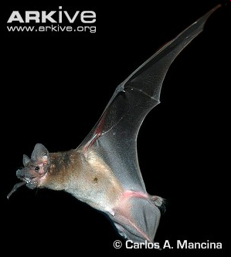
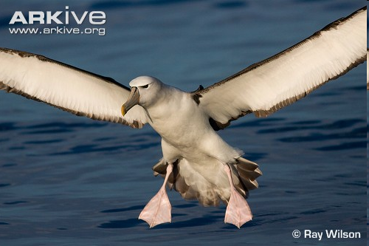
Why is there so much diversity?
Overlaps - convergent evolution
Little goblin bat
White-capped albatross
Notes:
Because of the way species evolve, they become different and more diverse over time.
However, sometimes there are overlaps in the types of ‘features’ that evolve, and different species evolve similar features entirely independently – this is called convergent evolution.
A classic example is wings. Both birds and bats have wings, but they evolved entirely independently of each other and the species are not related.
As well as genetics, the environment also plays a role in evolution; species evolve depending on the environment they live in. Some species evolved fur and claws, others evolved scales and fins for swimming etc.

Slide 12
Variation
Diversity within species is also known as variation
Variation = Genes + Environment
Causes of variation:
Genetic variation: mutations within genes
Environmental variation: acquired characteristics
Variation can be continuous or discontinuous
Variation is caused by both genes and the environment, but only variation caused by genes can be passed to offspring
Changes in the environment can result in rapid changes in a species
Notes:
Diversity within species is known as variation – most populations of organisms contain individuals that vary slightly from one another.
Differences (variations) between individuals are partly due to genotype and partly due to the environment:
Genetic variation – individuals have different characteristics as a result of mutations in their genetic code. Mutations can be passed to offspring – and these changes sometimes result in the appearance of new characteristics within the population.
Environmental variation – different characteristics caused by an organism’s environment (acquired characteristics)
Variation may be continuous (e.g. height) or discontinuous (e.g. blood type).
Variation can be caused by both genes and the environment, but only variation caused by genes can be passed on to the next generation.
When new forms of a gene arise because of mutation, a rapid change in a species may happen if the environment changes (use examples of peppered moths and bacteria and antibiotics if you want to discuss this further).
Genetic variation (or genetic diversity) is important for survival. Having a high diversity of genes within populations/species greatly reduces the risk from factors such as disease.
Genes are responsible for resistance to disease, and so species/populations with higher genetic diversity have a greater likelihood of possessing resistance compared to a species/population where genetic diversity is very low.
Higher genetic diversity within a species/population also reduces the negative effects associated with inbreeding, and also increases the potential of a species/population to adapt to changing climates.
Ask if anybody knows a scientist famous for his work on evolution.

Slide 13
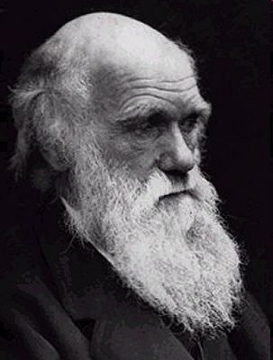
Darwin’s Discovery
1859 - Charles Darwin published On the Origin of Species
Culmination of his life’s work
Outlined theory of the evolution of species by natural selection
Species change over time due to natural selection, creating new and different species
Natural selection is also known as survival of the fittest
Notes:
So, what does all of this have to do with Darwin?
In 1859, Charles Darwin published a book called On the Origin of Species.
This was the culmination of 30 years of work, investigating how species come to be and how they are adapted to their environment.
The main part of the book outlined his theory of the evolution of species by natural selection.
In short, species change over time due to natural selection, creating new and different species.
Natural selection is also known as survival of the fittest.
Darwin’s theory is now widely accepted as being the best theory of the evolution of new species.

Slide 14
Voyage of the HMS Beagle
The majority of Darwin’s theories came from his voyage on the HMS Beagle
Set out in 1831 - journey lasted five years
Sailed around South America and Australasia carrying out surveying work
Darwin took detailed notes of what he saw and collected many specimens
Notes:
After Darwin graduated from university, his uncle helped him secure a place as a naturalist and companion to Captain Fitzroy on his boat the HMS Beagle.
They set off on the HMS Beagle in 1831 and sailed around South America and Australasia, surveying, collecting specimens and making detailed notes and drawings of all the different species they came across.
The journey lasted five years.

Slide 15
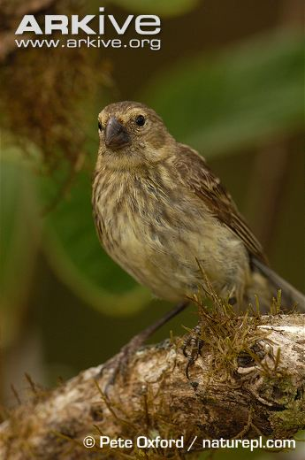
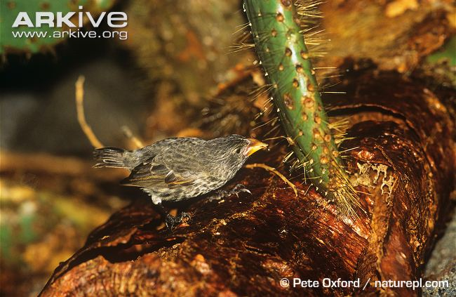
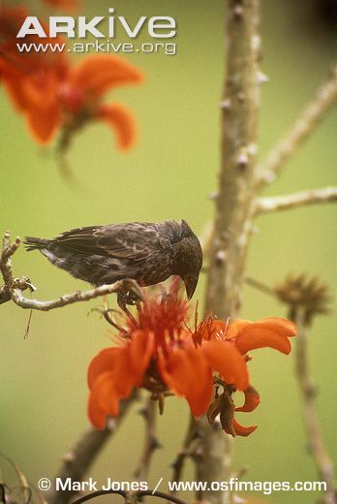
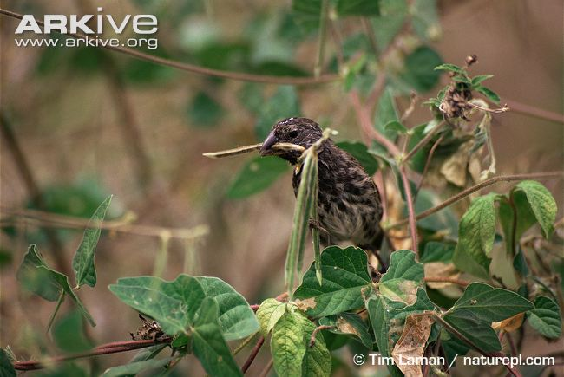
Darwin’s finches
Large cactus finch
Vegetarian finch
Medium ground finch
Common cactus-finch
Notes:
Of all his discoveries the most famous, and quite possibly most significant, was his observations of finches.
Most famously of all, Darwin saw thirteen different types of finches on the Galapagos Islands.
He noticed that, although similar in appearance, the different finch species varied in body size, beak size and shape, and behaviour.
He took many specimens of the different finches back to England for further study.

Slide 16
Theory of natural selection
Wide range of variation between individuals
Must compete for limited resources (e.g. food, light, mates)
Some may have characteristics enabling them to survive and reproduce more successfully
‘Successful’ characteristics are passed to offspring
Over time, more individuals will have these ‘successful’ characteristics
Those that are less well adapted and compete less successfully will die out, leaving only the ‘fittest’ to survive
Notes:
Natural selection - Within a species, individuals demonstrate a wide range of variation because of differences in their genes. Individuals within a population must compete for limited resources (e.g. food, light, space, mates), and some individuals may have genes which give them characteristics enabling them to survive better than other individuals with a different form of the gene.
Those individuals that are better suited to the environment in which they live are more likely to breed successfully, and their ‘successful’ genes will then be inherited by their offspring. As a result of genetic variation and competition on survival and reproduction, natural selection leads to an increasing number of individuals displaying beneficial characteristics (i.e. the traits making them better suited to their environment) in later generations. Given enough time, a new species will gradually evolve, and species that are unable to compete successfully will eventually become extinct.
Darwin made four important observations:
1. All organisms produce more offspring than can survive
2. Population numbers tend to remain fairly constant over long periods of time
3. Organisms show wide variation in characteristics
4. Some of these variations are inherited and passed on to the next generation.
Darwin made two deductions from his observations:
Because most offspring don’t survive, organisms must struggle for survival
Individuals that have characteristics that allow them to survive and reproduce will pass these characteristics on to their offspring
→ Survival of the fittest

Slide 17
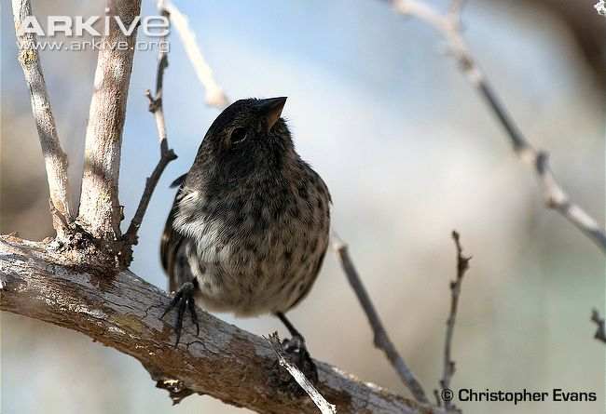
Darwin’s finches - activity
We are now going to explore how the finches helped Darwin to formulate his theory of natural selection.
Small ground-finch
Notes:
So, how did the finches that Darwin saw in the Galapagos Islands help him to formulate the theory of evolution?
The following activity will show the students, and help them to understand the theory of natural selection.
See Teachers’ Notes document for details of the activity.

Slide 18
Darwin’s finches – the results
Were some beak types more successful at feeding than others?
Was there any preference for different food types amongst the different species in Round 1?
Did all birds survive the drought in Round 2?
Vegetarian finch
Notes:
NB: You can pick a threshold point for ‘survival’ i.e. At least 50 food items, whatever they may be, need to be eaten in order for the bird to survive…which ones didn’t make it?
Q1. Were some beak types more successful at feeding than others?
A1. Yes
Which were the most successful? Spoons are generally the most successful feeders whereas toothpicks are the least.
Q2. Was there any preference for different food types amongst the different species in Round 1?
A2. Yes.
Which were preferred? Some beak types are more generalist (e.g. spoons can feed on everything), whereas some can only feed on one food type (e.g. toothpicks can only eat Styrofoam).
Q3. Did all birds survive the drought in Round 2?
A3. No
Toothpicks died out in the drought because their food wasn’t there anymore. Again, the more generalist species survived (they had other foods to choose from) whereas the specialist ones died out.

Slide 19
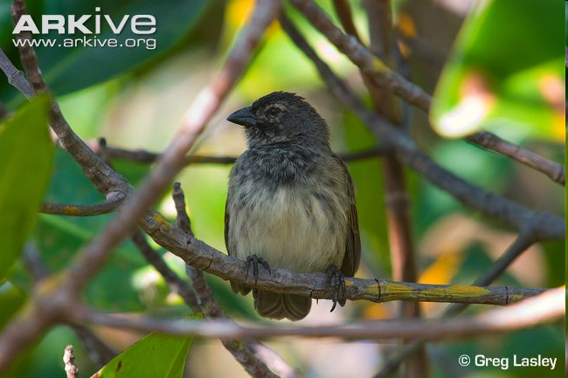
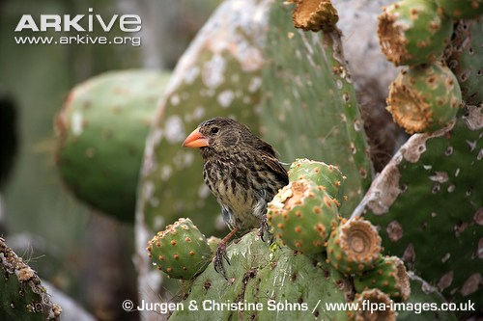
Darwin’s theory
Originally, small numbers of finches were blown onto the Galapagos Islands by storms
Darwin noticed each species of finch had particular adaptations to life on its specific island - habitat and food
Depending on the food available, birds with a particular beak shape were more successful than others
Mangrove finch
Medium ground finch
Notes:
So, how did this lead Darwin to come up with the theory of natural selection?
Darwin thought that the Galapagos Islands were originally colonised by small numbers of finches which were blown offshore from South America by storms.
He noticed that the species of finch on each island were adapted to the particular habitat and food sources there, and thought that it was unlikely that the finches would have been so well adapted when they arrived on the islands.
Darwin thought that the finches must have gradually changed over time to become more suited to their new home.
As demonstrated in the activity, depending on the food available on each island, some birds would have been more successful than others because of the natural variation in their beak shape.

Slide 20
But why?
In the original populations, the natural variation in beak shape was due to differences in the genes
→ different alleles code for different beak shapes
Due to the differences in the environment (e.g. food types available) alleles for certain beak shapes would be selected
This is because the more successful individuals survived long enough to breed and pass on their genes, producing young with ‘successful beaks’
Over time, this led to the formation of completely separate species → speciation
Notes:
In the original populations, this natural variation in beak shape was due to differences in the alleles.
Due to differences in the environment (such as food availability/type), certain alleles would have been ‘selected for’ more frequently. In other words, the birds with ‘successful’ beaks, would have survived long enough to breed, and pass on their ‘successful’ genes,
The finches with beaks that weren’t successful in picking up the food available on a given island would have slowly died out, just leaving the better adapted birds. These would then breed, and produce more birds with ‘successful’ beaks (genetics – pass on their genes for the successful traits).
Beak shapes must have changed, gradually, over time, to adapt to life on each particular island to make the most of the food type available.
Because each island had different food supplies, this led to a situation where finches with different sized and shaped beaks were found on different islands. Even if the finches were the same species when they got to the islands, this gradual change, which occurs over many successive generations, would make them more and more different until they became separate species. As time passed, the populations on different islands became so different that they could not interbreed - new species had evolved!
The combined effects of mutations, environmental changes, natural selection and isolation result in the creation of new species during the process of evolution.
The process is a very gradual change – over a long period of time the proportion of those individuals in the population with advantageous characteristics that are most suited to the environment will increase compared with the proportion of individuals with poorly adapted characteristics, and the poorly adapted characteristics may eventually be lost.

Slide 21
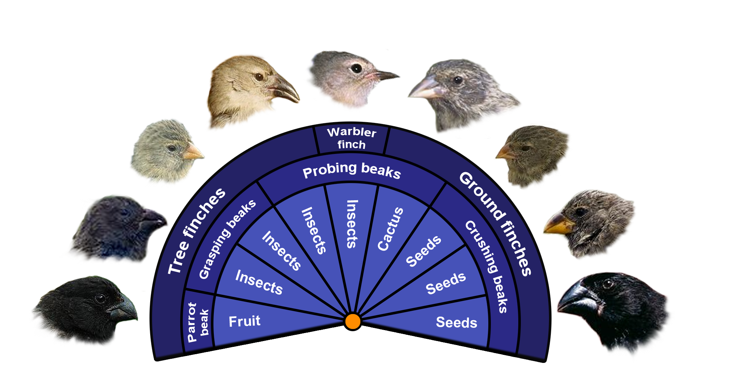
Darwin’s finches
Notes:
Notice the different beak shapes/types, and the foods each finch species eats.

Slide 22
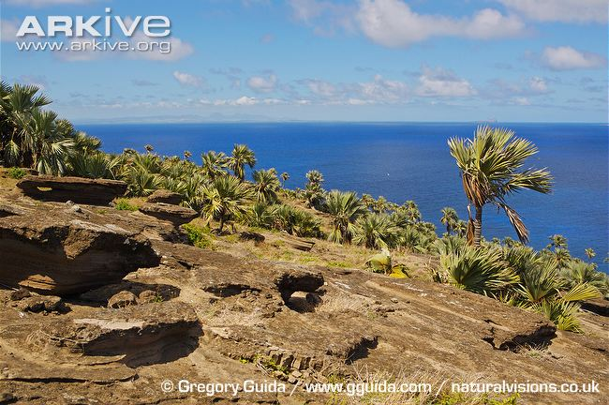
Evolution on islands
Blue latan palm
On many islands, there are unique species found nowhere else in the world
These are known as ‘endemic species’
Species that are separated by a geographic barrier (e.g. the sea) may not be able to move between islands to breed
results in reproductive and geographical isolation
Geographic isolation = allopatric speciation
Reproductive isolation = sympatric speciation
Notes:
Since Darwin’s work, islands have been very important in helping scientists to understand evolutionary processes.
On many islands there are endemic species – unique species found nowhere else in the world.
Endemic species are often (but not always) endangered because they usually have very small populations and restricted ranges, making them an important target for conservation.
Many islands with endemic species are very remote and the conditions on the island are unique, meaning that the species living on the island have evolved differently and in isolation from species on the mainland e.g. Madagascar and lemurs.
Reproductive isolation can lead to speciation – the creation of new species. A species is defined as a group of interbreeding populations that are reproductively isolated from other groups. Reproductive isolation can mean that sexual reproduction between individuals of the same (or different) species is impossible for physical, ecological, behavioural, temporal or developmental reasons.

Slide 23
Summary
Darwin’s finches - evolution on a small scale
Change in available food means finches with some beaks survive while others die out
This is natural selection
There are many different ‘pressures’ which can influence evolution - change in habitat, predators, mate preferences
Apply this on a worldwide scale….
....BIODIVERSITY
Notes:
Darwin’s finches are a great example of a situation where the mechanism for evolution can be evident on a smaller scale.
In our example, natural occurrences such as a change in available food caused some beaks to be more successful – this is natural selection - because the spoon beak is ‘selected’ over the chopstick beak
This is just one example of natural selection – other examples could be a change in available habitats, new predators (e.g. from an introduced species), different mate preferences or simply something like geographical separation (e.g. the finches blown to the Galapagos by storms would become different to those still on the mainland).
Now imagine increasing the scale and timescale of this and applying it to the whole world – across all the different habitats, conditions and continents and the sheer number of different selection pressures that could occur by chance – is it any wonder that we have such a diverse number of animal species on the planet? We haven’t even touched on all the different forms of life e.g. plants, algae, fungi, micro-organisms….

